Slide 1
Blood Demand Prediction
AI-Driven Emergency Preparedness System
Healthcare Innovation for Better Resource Management

Slide 2
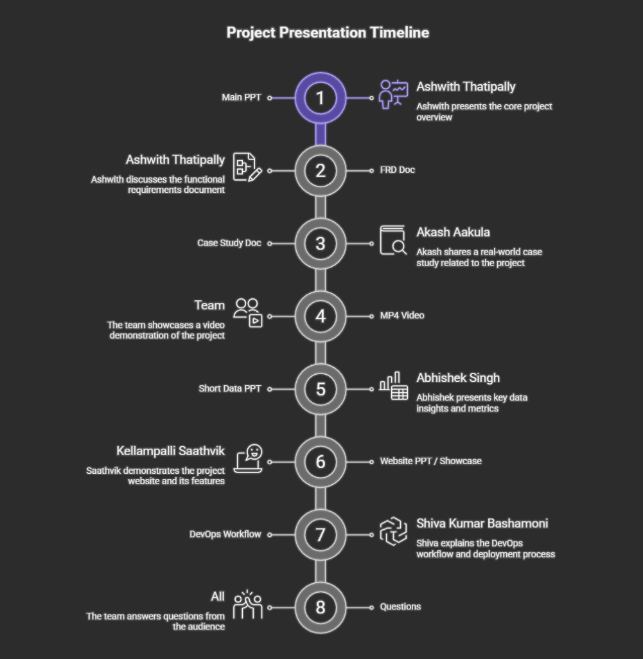

Slide 3
Why This Matters
Blood banks are critical lifelines during emergencies
Sudden spikes occur during accidents, surgeries, disasters
Reactive planning leads to stock-outs and delayed care
AI can shift from reactive to proactive planning

Slide 4
Tools Used
ChatGPT
Perplexity
Notebook LM
Gamma
Napkin AI
PowerPoint

Slide 5
Industry Overview
Current blood bank operations rely on historical averages and manual planning.
Challenge: Delayed response during emergencies
Impact: Frequent stock-outs and high procurement costs
Gap: No predictive capability for demand spikes

Slide 6
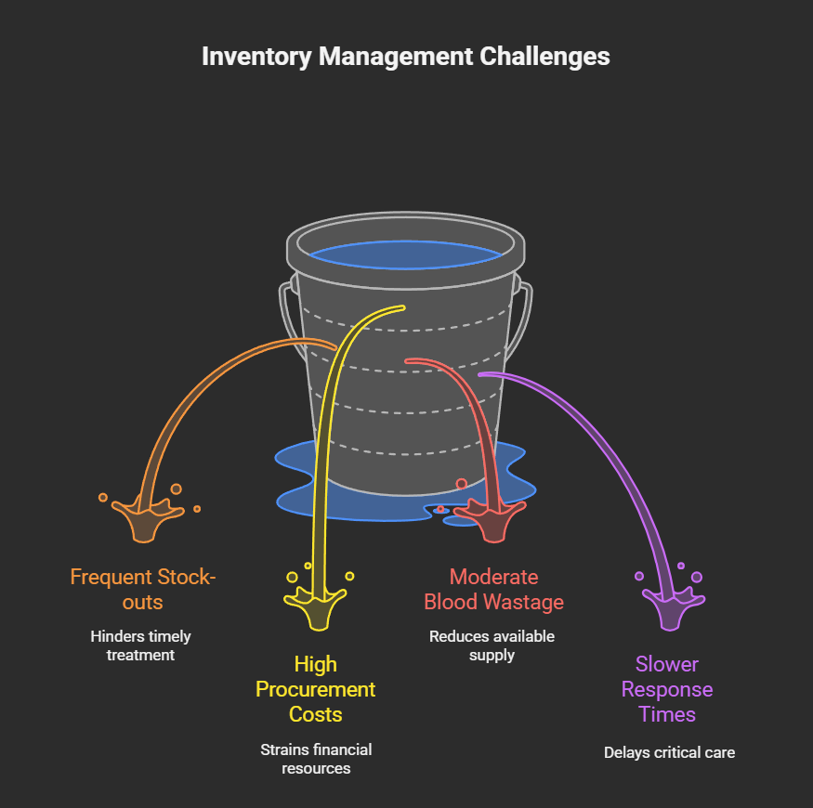

Slide 7
Data Inputs for Prediction
Data Source | Purpose
Historical Blood Usage | Identify consumption trends
Accident Records | Predict emergency demand spikes
Surgery Schedules | Estimate planned blood usage
Seasonal Trends | Account for predictable variations

Slide 8
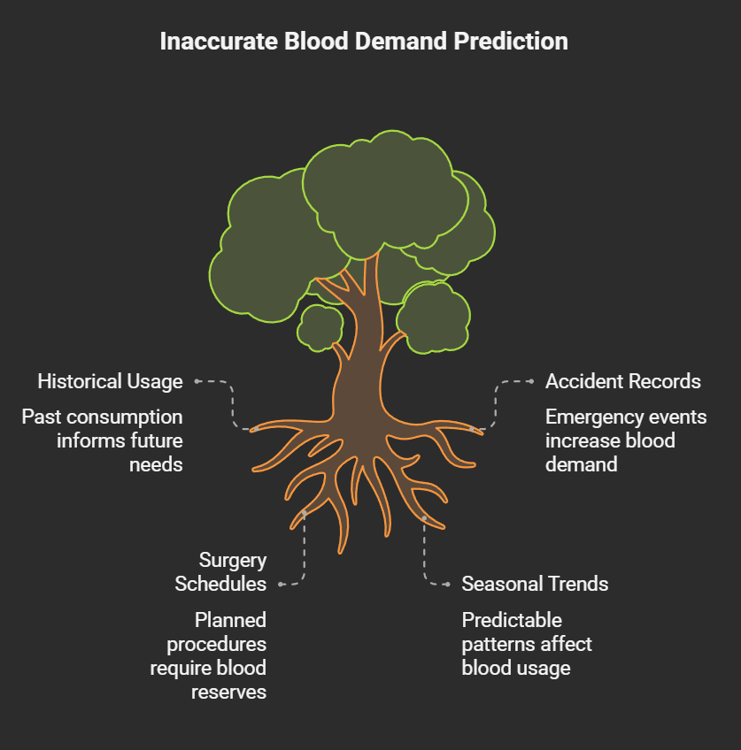

Slide 9
Monthly Blood Demand Trends
Month | O+ | A+ | B+ | AB+ | Total
Jan | 410 | 320 | 290 | 85 | 1,105
Jun | 520 | 410 | 370 | 110 | 1,410
Key insight: O+ has highest demand; demand increases seasonally

Slide 10
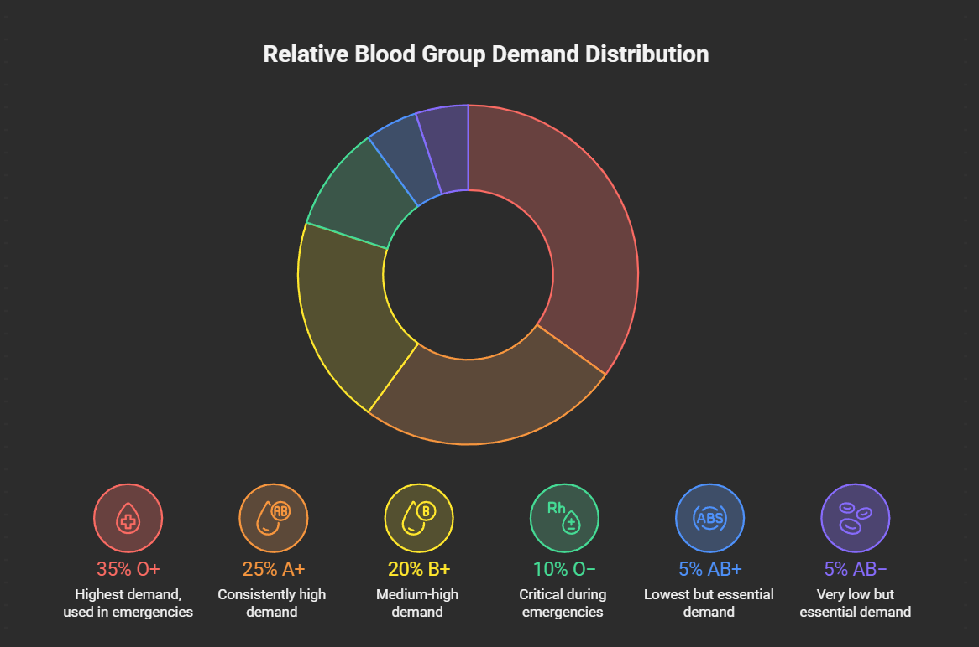

Slide 11
Emergency Demand Spikes
Event Type | Patients | Units Required
Road Accident | 12 | 38 units
Industrial Accident | 18 | 55 units
Natural Disaster | 40 | 120 units
Problem: Cannot handle with average-based planning alone

Slide 12
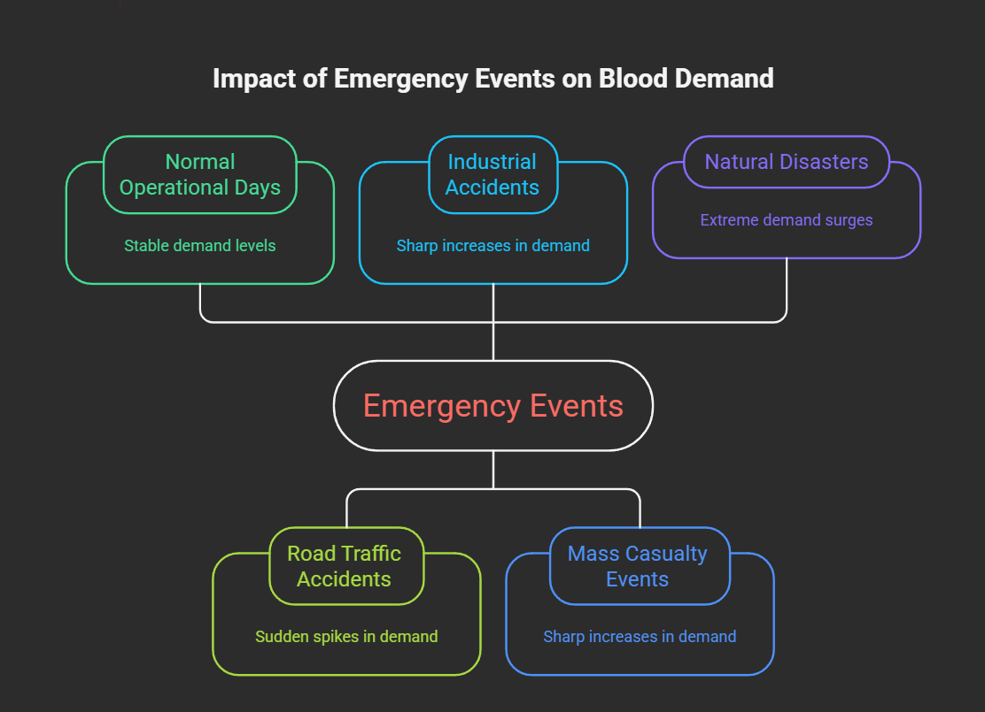

Slide 13
AI Prediction System Design
Input: Historical data, accident records, surgery schedules
Processing: AI model analyzes patterns and trends
Output: Demand forecasts and stock level recommendations
Action: Alerts to blood banks for proactive planning

Slide 14
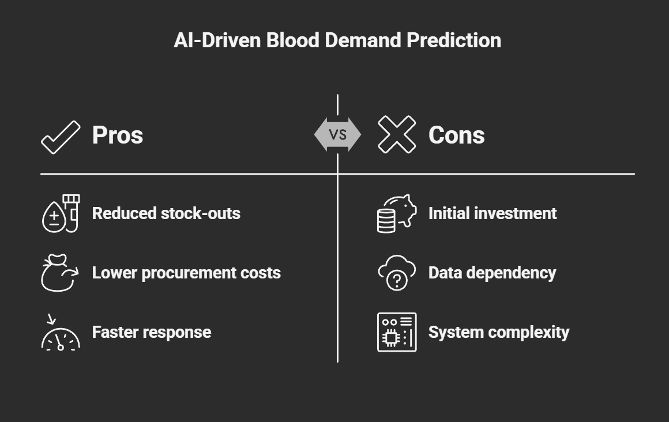

Slide 15
AI Prediction Accuracy
Month | Actual | AI Predicted | Variance
Jan | 1,268 | 1,245 | -23
Apr | 1,452 | 1,470 | +18
Jun | 1,580 | 1,602 | +22
Result: Predictions are close to actual demand

Slide 16
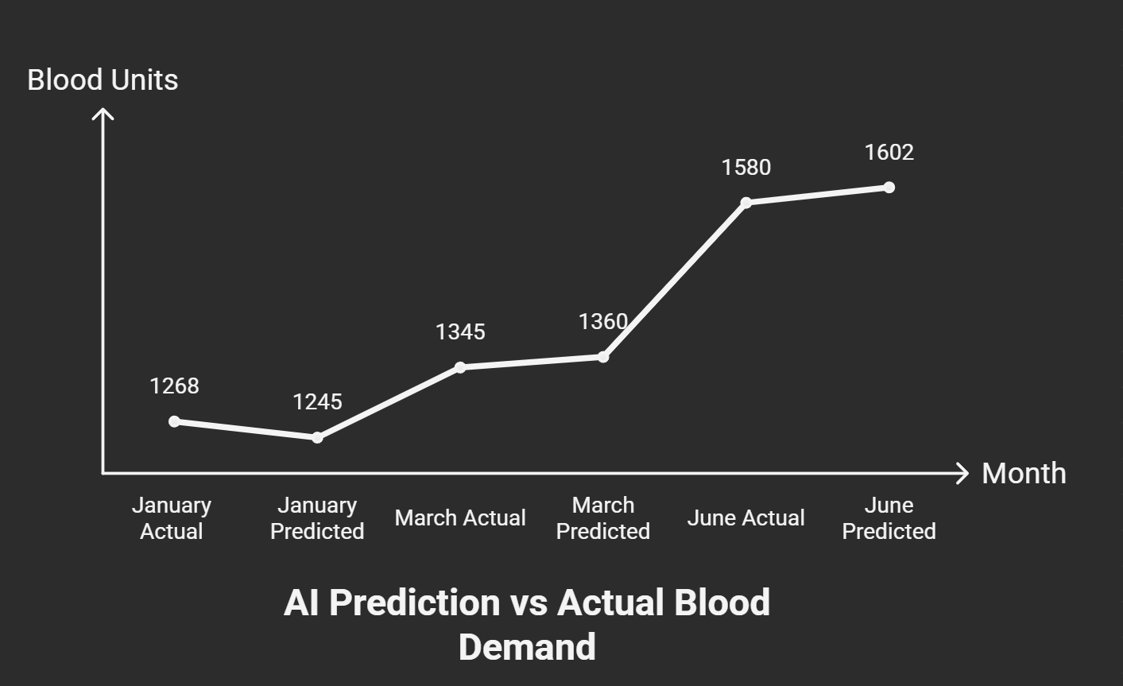

Slide 17
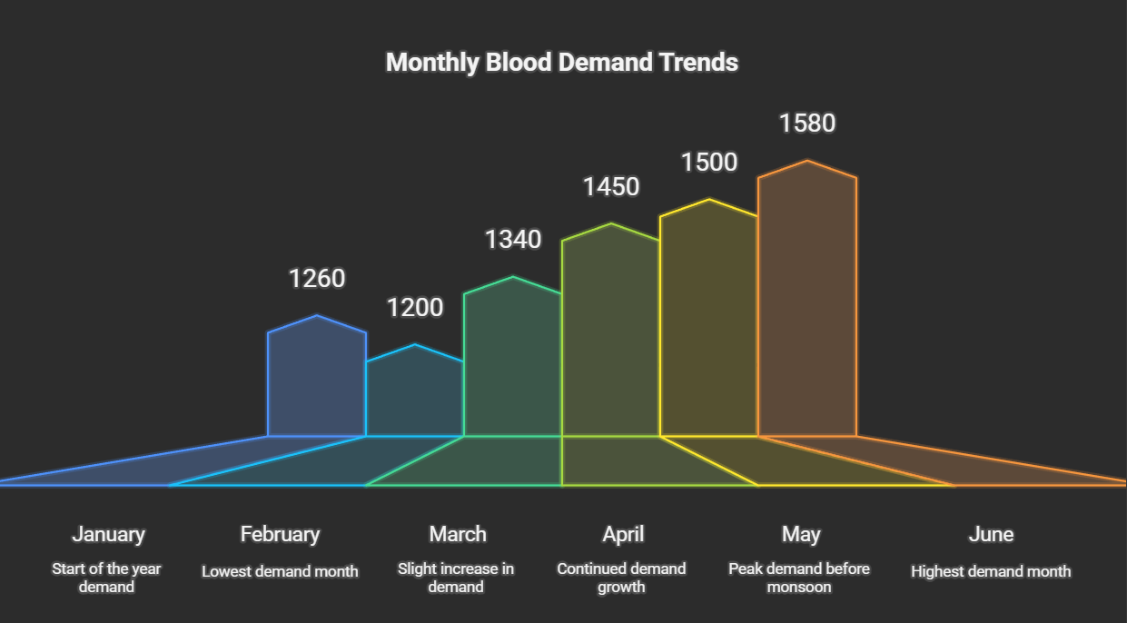

Slide 18
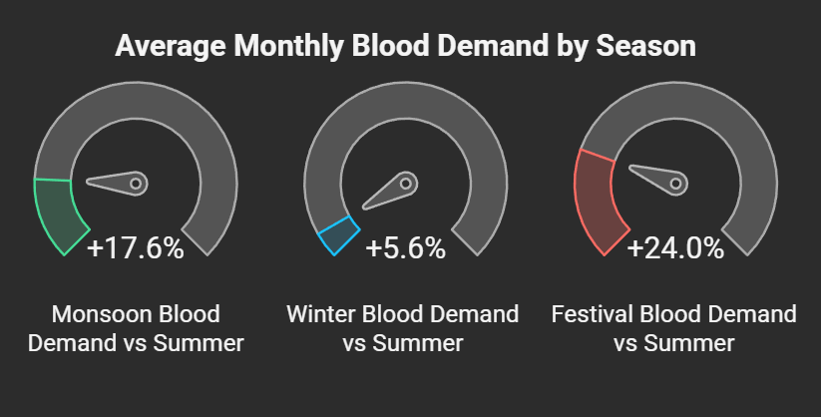

Slide 19
Business Impact: Before vs After
Metric | Before | After
Stock-outs/month | 6 | 2
Procurement Cost | ₹3,50,000 | ₹1,40,000
Blood Wastage | 9% | 4%
Response Time | 3.2 hrs | 1.4 hrs

Slide 20
Cost-Benefit Analysis
Investment: Software, data integration, staff training
Savings: ₹2,10,000/month in emergency procurement costs
Payoff: 2-3 months for ROI at scale
Benefits: Lives saved, better resource utilization

Slide 21
Feasibility Assessment
Technical: Existing AI/ML infrastructure is mature
Operational: Integrates with existing blood bank systems
Ethical: Transparent, supports human decision-making
Outcome: Highly feasible for implementation

Slide 22
Key Takeaways
From Reactive to Proactive: AI-driven prediction enables better planning
Cost Savings: ₹2,10,000/month reduction in emergency costs
Lives Saved: Faster response times, consistent blood availability
Proven Impact: Detailed data shows real operational benefits

Slide 23
Thank You!
Questions & Discussion
AI-Driven Blood Demand Prediction System

